Slide 1


CAPSTONE PROJECT
TechCrush Capstone Project
CAPSTONE PROJECT TOPIC 1:
Securing Data Transmission and Monitoring Network Traffic.
Disclaimer: This training material belongs to techcrush and shouldn’t be shared

Slide 2
CAPSTONE PROJECT
Group No.
Team Members
1.
2.
Disclaimer: This training material belongs to techcrush and shouldn’t be shared

Slide 3
CAPSTONE PROJECT
Outline
Aim and Objective
Methodology
Concept of project
Tools Used
Conclusion
References
Disclaimer: This training material belongs to techcrush and shouldn’t be shared

Slide 4
CAPSTONE PROJECT
Aim and Objective
Data Encryption and Hashing
File Transfer Over Network
Network Traffic Capture with Wireshark
Disclaimer: This training material belongs to techcrush and shouldn’t be shared

Slide 5
CAPSTONE PROJECT
Methodology
Data Encryption and Hashing: A file text named (group9ad) was encrypted using openssl on kali linux with the command line ‘openssl enc –e –des3 –salt –in group9ad –out group9adec –iter 1000’ which gave an encrypted output of file text named (group9adec). A hash value was generated for both the encrypted and unencrypted file text on kali linux, using the command line ‘sha256sum <file name>’
Disclaimer: This training material belongs to techcrush and shouldn’t be shared

Slide 6
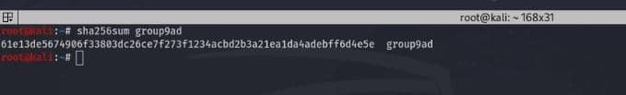
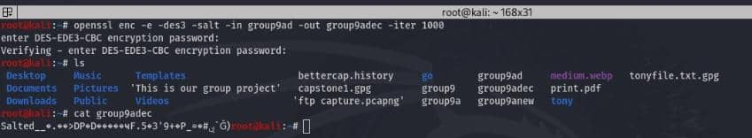
CAPSTONE PROJECT
Methodology
Data Encryption and Hashing
Disclaimer: This training material belongs to techcrush and shouldn’t be shared

Slide 7
CAPSTONE PROJECT
Methodology
File Transfer Over Network: Both the encrypted file text with the name (group9adec) and the unencrypted file text with the name (group9ad) was transferred using File Transfer Protocol(FTP) between windows and a kali linux operating system. This was done by creating an ftp server on the windows OS and hosting it with FILEZILLA. Then also an ftp client was download on Kali linux with the command ‘sudo apt install vsftpd’ and configured with the command ‘sudo nano /etc/vsftpd.conf’. After hosting the server on windows, then moved to kali linux and used the command ‘ftp <windows ip address>’ to establish a connection, then the command ‘put <file name>’ was used to transfer the files.
Disclaimer: This training material belongs to techcrush and shouldn’t be shared

Slide 8
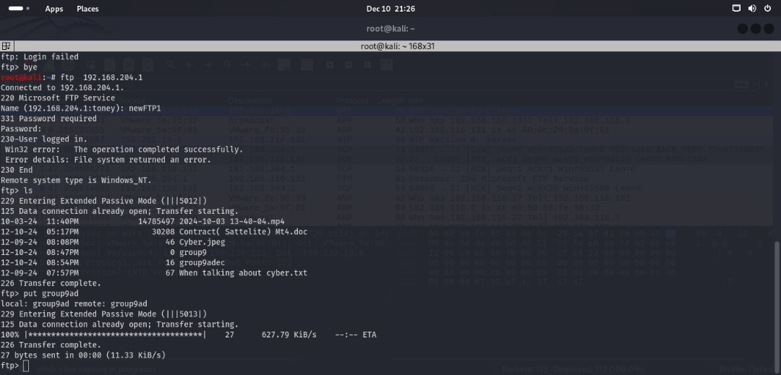
CAPSTONE PROJECT
Methodology: File Transfer Over Network
Disclaimer: This training material belongs to techcrush and shouldn’t be shared

Slide 9
CAPSTONE PROJECT
Methodology
Network Traffic Capture with Wireshark: wireshark was used to capture traffic of both the unencrypted file text with the name (group9ad) and encrypted file text with the name (group9adec) and identify packets during the file transfer process. The wireshark packet capture was filtered with ‘ftp-data’. And it was discovered after capturing the packets and following the stream that the unencrypted file was able to be read and extracted in plain text while the encrypted file still remained encrypted.
Disclaimer: This training material belongs to techcrush and shouldn’t be shared

Slide 10
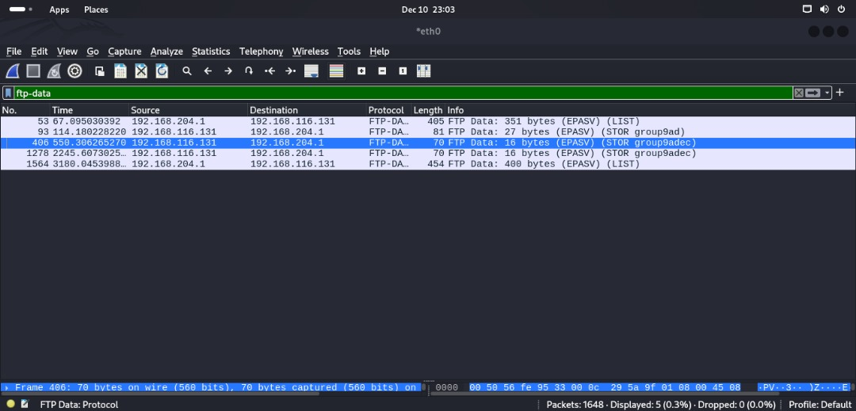
CAPSTONE PROJECT
Methodology
Network Traffic Capture with Wireshark:
Disclaimer: This training material belongs to techcrush and shouldn’t be shared

Slide 11
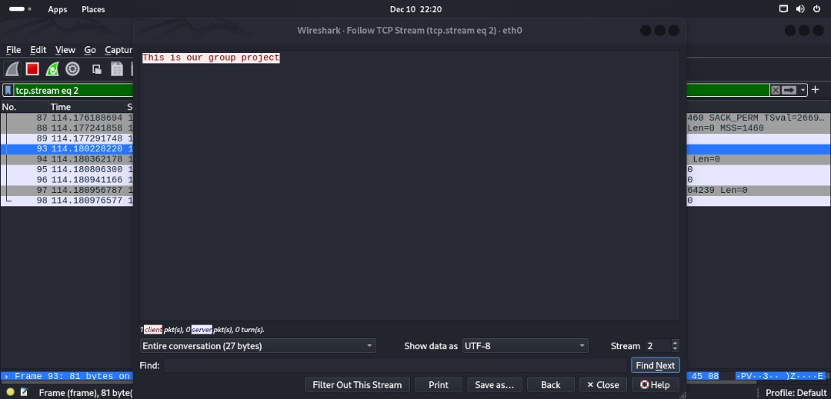
CAPSTONE PROJECT
Methodology
Network Traffic Capture with Wireshark:
Disclaimer: This training material belongs to techcrush and shouldn’t be shared

Slide 12
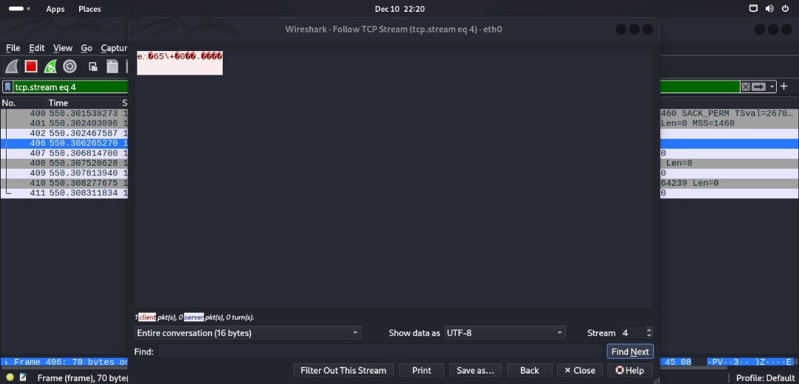
CAPSTONE PROJECT
Methodology
Network Traffic Capture with Wireshark:
Disclaimer: This training material belongs to techcrush and shouldn’t be shared

Slide 13
CAPSTONE PROJECT
Conclusion
Disclaimer: This training material belongs to techcrush and shouldn’t be shared

Slide 14
CAPSTONE PROJECT
References
Disclaimer: This training material belongs to techcrush and shouldn’t be shared

Slide 15
CAPSTONE PROJECT
THANK YOU
Disclaimer: This training material belongs to techcrush and shouldn’t be shared

